Slide 1



BANK LOAN OF CUSTOMERS
BY PIYUSH PRADHAN

Slide 2
BANK LOAN OF CUSTOMERS
PRIMARY OBJECTIVE
Analyze two datasets provided in CSV format, each containing 39,717 rows, for a Bank Loan of Customers project.
Assess the growth experienced by the bank in terms of loans within the specified years.
Utilize MS-Excel and MySQL for data analysis, cleaning, and removal of duplicates.
Develop interactive dashboards using Tableau and Power BI to visualize key insights.
Perform data normalization, calculations, and merging to present findings effectively.
Achieve the goal of examining the bank's loan growth trends over the given period.

Slide 3
BANK LOAN OF CUSTOMERS
KEY PERFORMANCE INDICATOR
KPI 1
KPI 2
YEAR WISE LOAN AMOUNT STATS
GRADE AND SUB GRADE WISE
REVOLVING BALANCE
KPI 5
KPI 3
HOME OWNERSHIP VS
LAST PAYMENT DATE STATS
TOTAL PAYMENT FOR VERIFIED STATUS VS
TOTAL PAYMENT FOR NON VERIFIED STATUS
KPI 4
STATE WISE AND LAST_CREDIT_PULL_D
WISE LOAN STATUS

Slide 4
KPI 1
YEAR WISE LOAN AMOUNT STATS

Slide 5
KPI 1
YEAR WISE LOAN AMOUNT STATS
In 2007, the total loan amount was 22,19,275.
By 2008, the loan amount increased by approximately 548.75% to reach 14,39,02,75.
In 2009, there was a further increase, with the loan amount reaching 46,43,63,25, indicating a percentage increase of approximately 222.64% from 2008.
By 2010, the loan amount surged to 1,22,05,200, reflecting a percentage increase of approximately 162.69% from 2009.
In 2011, the total loan amount peaked at 2,60,50,675, showing a percentage increase of approximately 113.47% from 2010.
From 2007 to 2011, the overall loan amount increased by approximately 11,38,31,400, representing a percentage increase of approximately 51198.21%.

Slide 6
KPI 2
GRADE AND SUB GRADE WISE REVOLVING BALANCE

Slide 7
KPI 2
GRADE AND SUB GRADE WISE REVOLVING BALANCE
Grade-B exhibits the highest revolving balance among all grades, while Grade-G displays the lowest.
Grade-B customers typically have higher annual incomes and longer employment periods exceeding 10 years.
A higher annual income results in a lower Debt-to-Income ratio, making Grade-B customers more likely to take out loans.
The trend of higher revolving balances corresponds with the order of annual incomes across grades, with Grade-B having the highest balance followed by Grade-A, Grade-C, and so forth, down to Grade-G.
Total revolving balance is 532 Million.

Slide 8
KPI 3
TOTAL PAYMENT FOR VERIFIED STATUS VS
TOTAL PAYMENT FOR NON VERIFIED STATUS

Slide 9
KPI 3
TOTAL PAYMENT FOR VERIFIED STATUS VS
TOTAL PAYMENT FOR NON VERIFIED STATUS
The pie chart illustrates the distribution of loan payment statuses, distinguishing between "verified" and "not verified" payments.
Approximately 58.88% of the total payments are categorized as "verified," indicating that they have undergone verification processes.
Conversely, around 41.12% of the total payments fall under the category of "not verified," suggesting that these payments have not undergone verification procedures.
This distribution highlights a substantial portion of payments being verified, indicating a significant level of scrutiny and validation applied to these transactions.

Slide 10
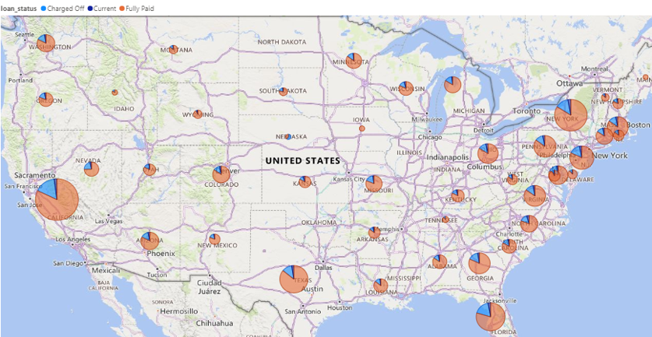
KPI 4
STATE WISE AND LAST_CREDIT_PULL_D WISE LOAN STATUS
The map visual provides us insight on count of bank clientele across states according to date of last activity and loan status. For instance, from 7099 clients of California(CA), 5823 members had Fully paid status, 1124 had charged off status and 150 had current status.
This graph also shows us that most of the Financially active population resides in
south-western coast and western coast.

Slide 11
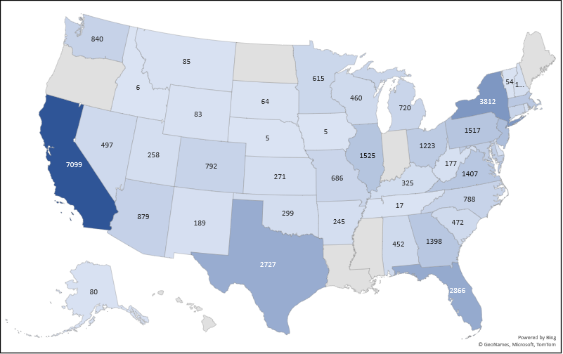
KPI 4.1
STATE-LEVEL BREAKDOWN OF BANK CLIENTS
The graph indicates a significant difference in bank clientele across regions. California (CA) has the highest number of clients at 7099, while Iowa (IA) and Nebraska (NE) have the lowest, each with just 5 clients.

Slide 12
KPI 5
HOME OWNERSHIP VS LAST PAYMENT DATE STATS

Slide 13
KPI 5
HOME OWNERSHIP VS LAST PAYMENT DATE STATS
Mortgage Rise: Our data reveals a steady increase in mortgages over the period (2008-2016). This trend suggests a rise in the number of people financing home purchases.
Ownership Decline: Interestingly, the data shows a decline in the number of homes owned outright (without a mortgage). This could indicate factors like people using their equity for other investments or difficulty paying off mortgages.
Rental Market Presence: The data also highlights the presence of a significant rental market throughout the period. Examining the size of the rental market compared to owned and mortgaged homes could provide further insights.

Slide 14

THANK YOU

